Slide 1
Analyzing Performance of Various Machine Learning Algorithms on Walmart Stock Price Data
Premchand Avanigadda
Aakarsh Nadella
Veera Venkata Sai Naveen Bodangi
Vinay Kumar Nalla

Slide 2
Project Overview
To apply and understand concepts of Machine Learning Algorithms.
To analyze the dataset and forecast the values
Algorithms used :
ARIMA Auto Regressive Integrated Moving Average
Artificial Neural Network
Support Vector Machines
Comparing the performance of the above Algorithms

Slide 3
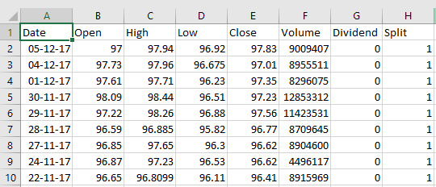
DATASET
WALMART STOCK DATA
Attributes : DATE, HIGH, OPEN, LOW, CLOSE, SPLIT, DIVIDEND
Dataset ranges from August 1972 – December 2017
Total Rows – 11,425
Source: https://www.quandl.com/data/EOD/WMT-Wal-Mart-Stores-Inc-WMT-Stock-Prices-Dividends-and-Splits

Slide 4
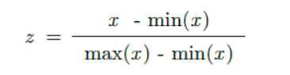
DATA PRE-PROCESSING
Transforming Raw Data to Understandable format.
WHY ?
To remove Inconsistent data or Outliers
To remove Incomplete data or NULL Values
To scale data
Min – Max Normalization

Slide 5
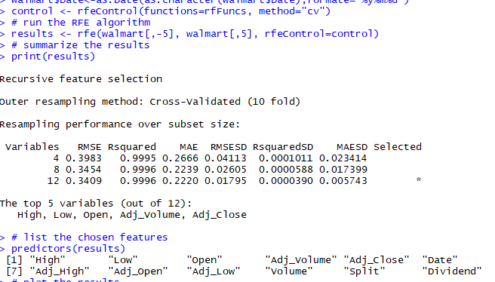
FEATURE SELECTION
Finding the right set of attributes to determine the dependent variable
Why ?
Reducing Noise and chances of Overfitting
To reduce Time
Simplified Model
Improving Efficiency
Recursive Feature Elimination Using Random Forest Algorithm
Large collection of correlated trees
Trees are generated randomly with n-samples and classifier variable.
Ranking is given according to classifier variable.
Process is iterated leaving one feature in each iteration.

Slide 6
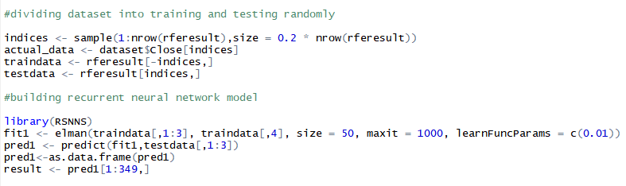
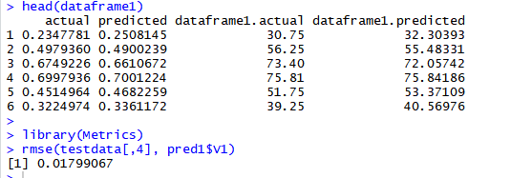
Artificial Neural Network
Learns itself how to do things
Architecture similar to Human Brain
Recurrent Neural Networks
Output of layer is sent to the input of the next and is fed back to the same layer.
Need a mechanism to store what has happened in the past.
Elman Network together with LSTM

Slide 7
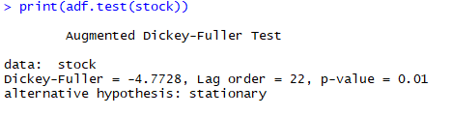
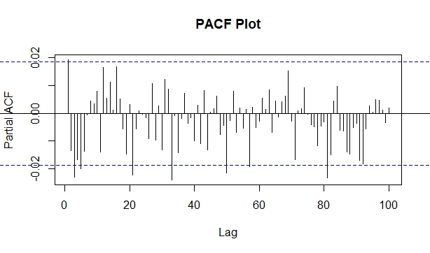
ARIMA - Auto Regressive Integrated Moving Average
3 methods
Auto Regressive (AR)
Differencing(I)
Moving Average(MA)
Arima(p,d,q)
Steps involved
Stationarity Test (d=0,1,2 …)
Identifying the p order of AR Model (From PACF Plot)
Identifying the q order of MA Model (From ACF PLot)

Slide 8
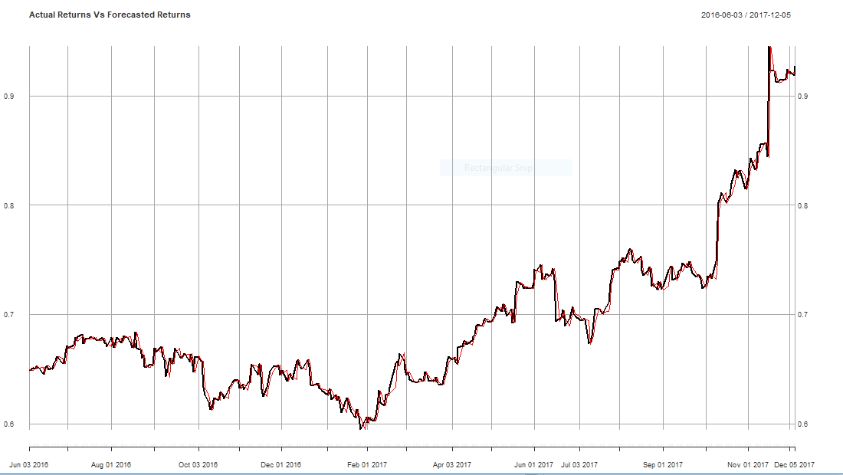
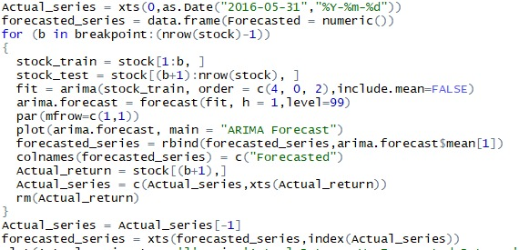
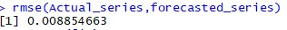
ARIMA Contd’

Slide 9
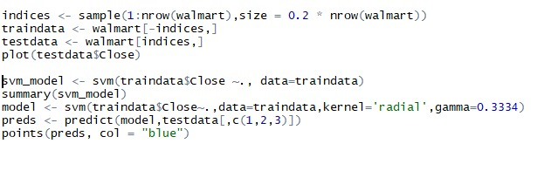
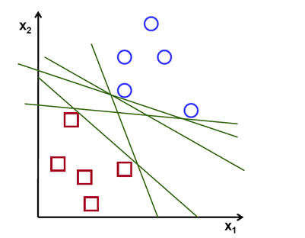
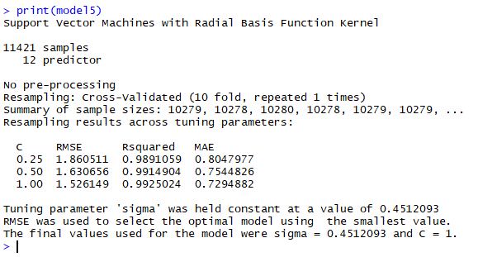
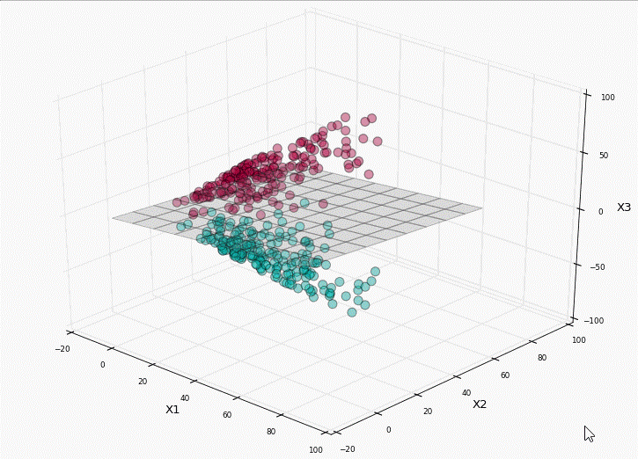
Support Vector Machines (SVM)
Hyperplane
Non-linear Data points
Polynomial Kernel
RBF kernel

Slide 10
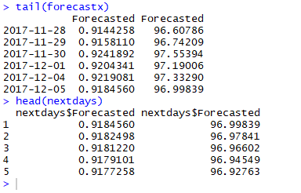
Comparison
 | Neural Network | ARIMA | SVM
RMSE | 0.0179 | 0.00885 | 1.6306
Among all the algorithms used ARIMA shows least error rate for this particular dataset.
Are you planning to buy Walmart Stock in this week ?
Hold On !!!

